Slide 1
What should the next government do for people with multiple needs? Date: Location:
Supported by
Notes:
These slides are designed to help you facilitate a workshop about policy on multiple needs.
Notes like these will give you advice and extra information.

Slide 2
2. Voices from the Frontline
Voices from the Frontline is a project run by Making Every Adult Matter (MEAM), a coalition of four national charities with expertise in homelessness, criminal justice, substance misuse and mental health
Our aim is to bring the voices of people with multiple needs and those who support them to the heart of the policy debate
Notes:
Making Every Adult Matter (MEAM) is a coalition of four national charities – Clinks, DrugScope, Homeless Link and Mind – formed to influence policy and services for adults facing multiple needs and exclusions. Together the charities represent over 1600 frontline organisations working in the criminal justice, drug and drug treatment, homelessness and mental health sectors.
People facing multiple needs and exclusions are in every community in Britain. They experience several problems at the same time, such as mental ill health, homelessness, drug and alcohol misuse, offending and family breakdown. They have ineffective contact with services, and are living chaotic lives.
For more information on Voices from the Frontline, visit our website:
meam.org.uk/voices

Slide 3
3. What are multiple needs?
Experiencing multiple needs means facing more than one problem at the same time, including:
Homelessness
Contact with the criminal justice system
Mental health problems
Substance misuse
“It’s just got to the point where all of these things have come into a massive great big circle… you’re banging your head against a brick wall.”

Slide 4
4. Today’s aims
We would like to work with you to think about how changes to policy can improve things for people with multiple needs.
Together we will:
Briefly explore what policymaking is and who is involved in it
Think about what needs to change in terms of the way services are provided for people with multiple needs
Consider how policy changes might help with this
Be positive and focus on the solutions
Notes:
This slide gives an overview of the rest of the presentation.
You can tell people that the Voices from the Frontline team will be putting some of the things that people tell us into a report. We are planning to give this to the next government in May – whoever they are!
We expect that working through this presentation will take about one hour (although you might want to spend longer).

Slide 5
5. What is policy-making?
‘…the formulation of ideas or plans that are used by an organization or government as a basis for making decisions.’
The government, your local council and other organisations make decisions every day that affect all of our lives:
Spending money on healthcare, schools, benefits and other services, and deciding how they work
Raising money through the taxes we pay
Making new laws or changing old ones
Notes:
The quote at the top of this slide comes from the Collins English Dictionary, but what does it actually mean in practice?
The government, your local council and other organisations make decisions every day that affect all of our lives. In doing this, they need to decide what they want to achieve and what action they should take – or ask others to take – to make it happen.
The next slide will explore who is involved in making these decisions.

Slide 6
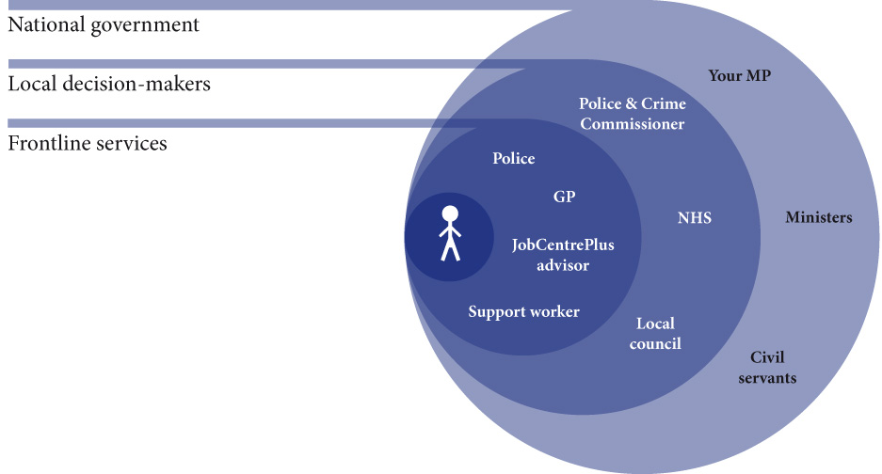
6. Who is involved in policymaking?
Notes:
A policy will often have to pass through a number of layers before it gets to the people it’s designed to help. This diagram shows some of the people and organisations involved (there are many more we haven’t included).
When thinking about what needs to change for people with multiple needs it is really important to consider who might make that change happen:
People with multiple needs are experts by experience. They know first-hand what works and make individual choices about change.
Frontline services work directly with people and have a key role to play in how support is delivered.
Local decision-makers, such as councils and NHS Clinical Commissioning Groups, decide which services to commission, how money is spent, and how services operate.
National government includes MPs (Members of Parliament) and civil servants. MPs are elected to represent their area and the decisions they make impact on local decision makers and frontline services. Some MPs have special responsibilities in government as Ministers. Civil servants also work nationally. These are people who work for the government, but are not politicians. They put the decisions of Ministers into practice, and provide expert advice to them, so they are really good people to meet with.

Slide 7
7. How can we improve policy together?
Experts by experience and those who support them have a vital role to play in persuading different decision makers to act. This might involve:
sharing our experiences and telling policymakers things they might not already know;
telling them about things that we know work;
giving them ideas for how to improve things; and
showing them that we (and others) care about this issue.
Notes:
When we say experts by experience, we mean people who are experiencing multiple needs.
And we can use lots of different methods to try and persuade people to act on certain issues. Some examples might include:
meeting with MPs, civil servants councillors and other officials;
writing letters and asking questions;
doing research and writing reports; and
campaigning (in the newspapers and on the internet).

Slide 8
8. What are your experiences of having multiple needs?
Drawing on your own experiences, or thinking about the two fictional characters below, we would like you to think about:
What experiences are people with multiple needs likely to have?
What organisations/support services are people with multiple needs likely to have contact with?
“Nina (21) and Simon (36) both have multiple needs.
Notes:
At this point, you can open up the discussion.
Tell the group that over the next few slides, we’re going to look at three things:
what people’s experiences of multiple needs are (this slide);
how they might be different in an ideal world;
and finally what might help to change that.
People can either talk about their own experiences, or if they would feel more comfortable, use the fictional characters on the slides.
Although we want the focus of the workshop to be as positive and as possible, for this slide you might encourage people to think about some of the issues they or the people they are supporting have experienced.
Plan to spend about 10 minutes talking about this

Slide 9
9. How would things be different in an ideal world?
From thinking about the issues, we now want to focus on some of the solutions.
If you could design a programme of support for Nina and Simon, what would this look like?
What has worked for you?
What needs to change to make this happen?
Notes:
Hopefully in the last discussion, people have begun to think about what some of the problems or issues are for people experiencing multiple needs.
On this slide, you can ask them to start thinking about the solutions. It can help to encourage people to be as positive as possible: by thinking about what has worked, you can start to explore where else this ‘good practice’ can take place.
This discussion needs to be as broad as possible, and you or someone else should write people’s ideas on flip charts, or something similar. These ideas, especially the ones relating to the last question, will be shaped in the next part of the workshop.
Plan to spend about 15 minutes thinking of possible solutions

Slide 10
10. What might help to change things?
Now you’ve thought about solutions, consider these questions.
Do things need to change at a local or national level?
Is this a change that needs to be made by frontline services, local decision makers or is it a national change?
Who do we need to act to make these changes happen?
Do you think there might be any barriers to what you have suggested? (For instance, cost.)
Why should they listen – what’s in it for them?
Notes:
Finally, it’s time to look at any possible solutions that people have talked about, and how you might go about implementing them in the light of the earlier discussion about policymaking.
You can using the questions on the slide as prompts or guiding points to help people develop their ideas into more focused policy recommendations.
For this part of the workshop, it would probably be useful for people if they referred back to slide 5 and reminded themselves of the policy context.
At the end of this section, it is really important that people’s ideas are summarised and there is general agreement from the group that they have captured their thoughts.
The ideas might not be fully developed into policy recommendations at this point, but this should be a really good start to that process.
Plan to spend 20 minutes talking about this

Slide 11
What next?
If a Minister was sitting here now, what’s the one thing you’d say to them?
To help us share your ideas, tell us about what you’ve discussed before the end of March 2015.
You can contact the team at voices@meam.org.uk

